Slide 1

JavaScript Asynchronous
Mr. Mohan Kumar T G
Asst. Professor,
Dept. ISE, NMIT,
Bengaluru

Slide 2

JavaScript async/await
async keyword is used with a function to represent that the function is an asynchronous function. The async function returns a promise.
The syntax of async function is
Here, name - name of the function,
parameters – parameters that are passed to the function
Since this function returns a promise, you can use the chaining method then().

Slide 3

JavaScript await Keyword
The await keyword is used inside the async function to wait for the asynchronous operation.
The syntax to use await is:
let result = await promise;
The use of await pauses the async function until the promise returns a result (resolve or reject) value.

Slide 4
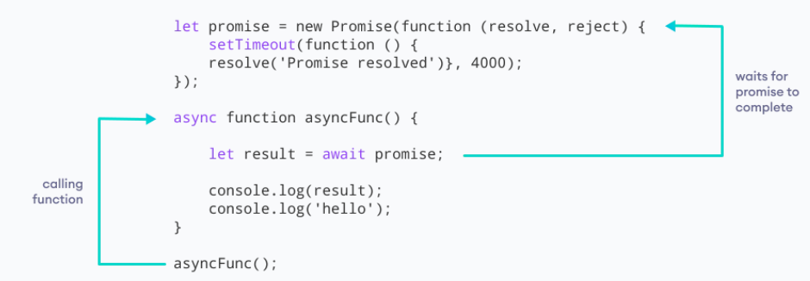
Working of async / await function

Slide 5
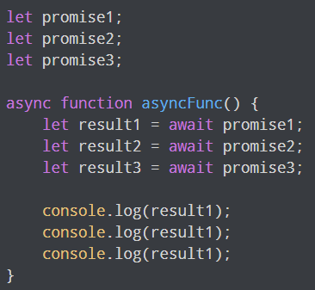
Working of async function
The async function allows the asynchronous method to be executed in a seemingly synchronous way. Though the operation is asynchronous, it seems that the operation is executed in synchronous manner.
This can be useful if there are multiple promises in the program.
await waits for each promise to be complete.

Slide 6

Error Handling
While using the async function, you write the code in a synchronous manner. And you can also use the catch() method to catch the error.

Slide 7
Benefits of using async function
The code is more readable than using a callback or a promise.
Error handling is simpler.
Debugging is easier.

Slide 8
Asynchronous is best suited when processing the following requests:
I/O bound requests. Examples : writing/reading to a file or database, making API calls, calling hardware like printers etc.
CPU bound requests (requires CPU time). Examples : looping through thousands of objects, complex lengthy calculations, processing millions of data points etc

Slide 9
Why should we use asynchronous (practical use cases)?
Responsive UI (Client side)
Example : A mobile app has 2 buttons, Button 1 gets detail weather forecast for 7 days (lets say request takes 5 seconds to process) & Button 2 changes the font color of the app. When a user selects Button 1, UI must not freeze!! The user must be allowed to select Button 2 (change font color) while the app is fetching weather data in the background. These are two independent functionalities.

Slide 10
Use case 2 & 3:
Fire And Forget / Process Independent Data (Server Side) Example : An API first returns the user requested data (so the user is not kept waiting), then in the background it does some complex calculations (requires CPU time). At the end it sends the result to a third party service. Here we can use asynchronous programming to allocate a thread for carrying out the entire background process and then forget about it.
Scaling and Efficiency (Server side) Example : Lets assume there is a back-end service which upon request is making a lot of database calls (writing to/reading from it). If such a service is expected to get a high number of requests and these requests need to be completed within a certain time (SLA), then async is the perfect choice. Async will help scale the service and make best use of the resources available.

